Slide 1
BEST PLACE TO OPEN A GYM
Author name :- PRINCE

Slide 2
Project Goals
Goal of this project is to find best place to open a gym which can be more profitable for Businessman
It also helps to find out which place has more concentration of Gyms than other Neighborhood.

Slide 3
INTRODUCTION
The objective of this capstone project is to find the best place to open a gym in Delhi.
Delhi , capital of India have high population of people and opening a new business here can be a great success if any businessman know the suitable place for business which give them an advantage on competitors.
-for more info…List location or contact for specification (or other related documents)

Slide 4
Data acquisition and cleaning
For this project, I used two data sets to execute my idea :-
Delhi’s places data
Foursquare Location Data
Delhi’s places data - This data is collected from the Kaggle site.
2. Foursquare Location Data - For getting the venues information nearby each Neighborhood I used Foursquare API .

Slide 5
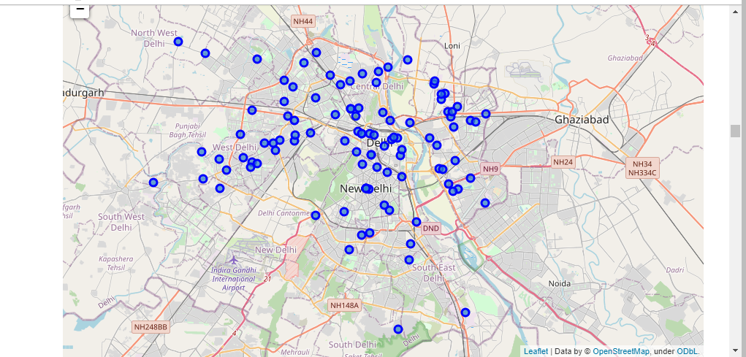
ANALYSIS SECTION
Visualizing all Neighborhood in Delhi using Folium map.

Slide 6
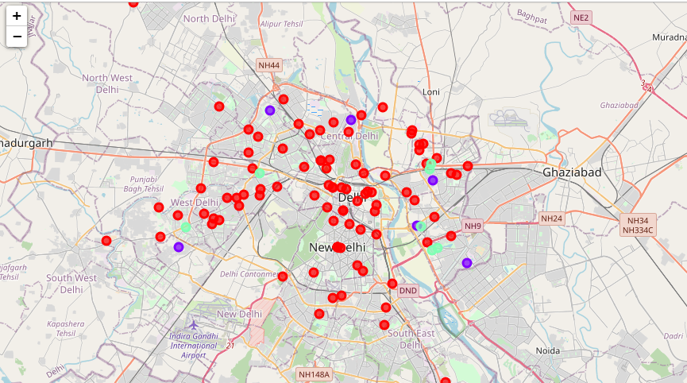
After analyzing and making cluster, making map of the Neighborhoods with its cluster label.
Here,
Red color marker denotes ----> cluster 0
Blue color marker denotes ----> cluster 1
Green color marker denotes ----> cluster 2

Slide 7
RESULTS
The results of the clustering are visualized in the map below.
The Red color is Cluster 0 , the blue color is Cluster 1 and the green color is cluster 2.
· Cluster 0: Areas with no Gyms.
· Cluster 1: Areas with low number of Gyms
· Cluster 2: Areas with moderate number of Gyms.

Slide 8
DISCUSSION SECTION
In , this project we only consider one factor i.e frequency of occurrence of gyms in a neighborhood , there are also other factors like population of people in neighborhood , rating of gyms in each locality , rate of land or rent for opening a gym that could influence the decision of opening a new gym. However , this type of data is couldn’t obtained easily. So, it is out of scope of this project.
Also, we don’t include the Neighborhoods of Southern Delhi region as it will make the visualization of maps a little bit confusing.
Future research may can bypass these limitations by getting paid-information and obtain more and accurate results.
-for more info…List location or contact for specification (or other related documents)

Slide 9
CONCLUSION
In this project, I put all Neighborhood data into 3 clusters based on their similarities, and lastly providing recommendations to the relevant stakeholders i.e. businessman and investors regarding the best locations to open a new gym.
To answer the business question that was raised in the introduction session , the answer proposed by this project is: --> The Areas in cluster 0 are the most preferred locations to open a new gym.
-for more info…List location or contact for specification (or other related documents)

Slide 10
Current Status
High-level overview of progress against schedule.
On-track in what areas
Behind in what areas
Ahead in what areas
Unexpected delays or issues.

Slide 11
Related Documents
Marketing plan
Location or contact name/phone
Budget
Location or contact name/phone
Post-mortem
Location or contact name/phone
Submit questions
Location or contact name/phone

